Slide 1

ELL Leadership Academy
Karina E. Chapa, M.Ed.
Language Proficiency, Biliteracy and Cultural Diversity Director
kchapa@esc1.net
Twitter @esc1bilingual @bilingualpride

Slide 2

Online Tutorials and Practice Tests
https://www.texasassessment.com/administrators/technology/

Slide 3
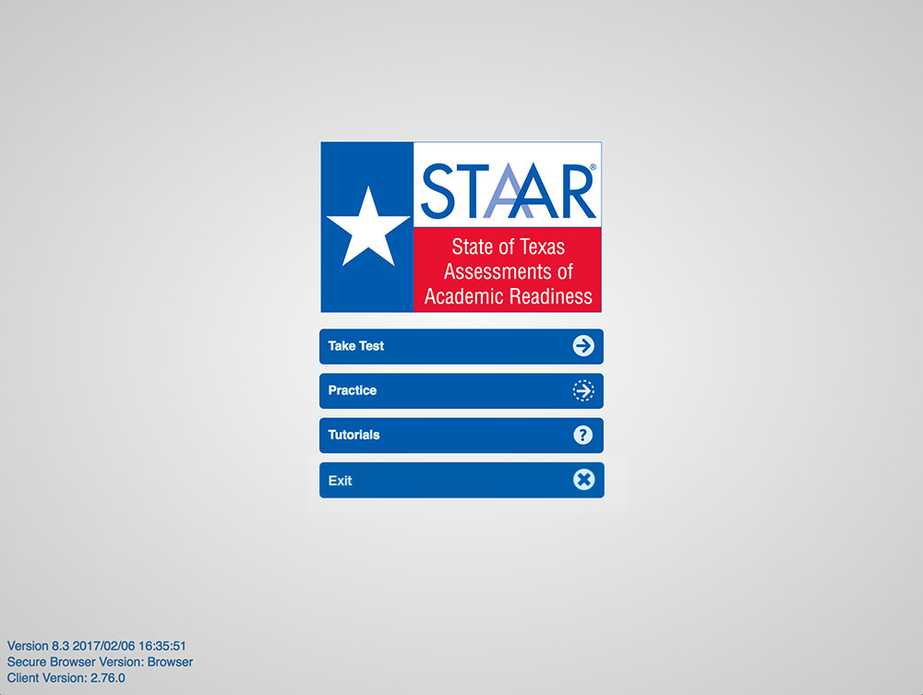
STAAR Online Tutorials
When you open the STAAR online testing platform, you will see a menu of options, including “Tutorials.”
Will be updated for 2018 Administration

Slide 4
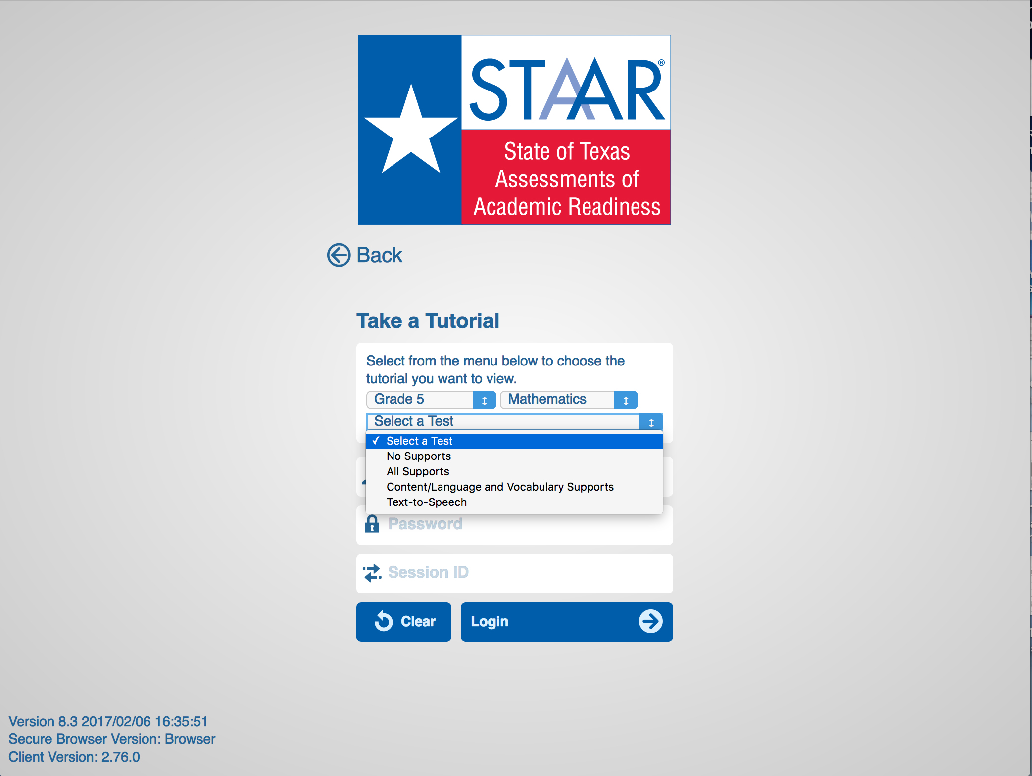
STAAR Online Tutorials
Once you select “Tutorials,” you will be taken to a screen with several drop-down menus.
Choose the grade, subject, and test (i.e., available supports) you want to view.
Will be updated for 2018 Administration

Slide 5
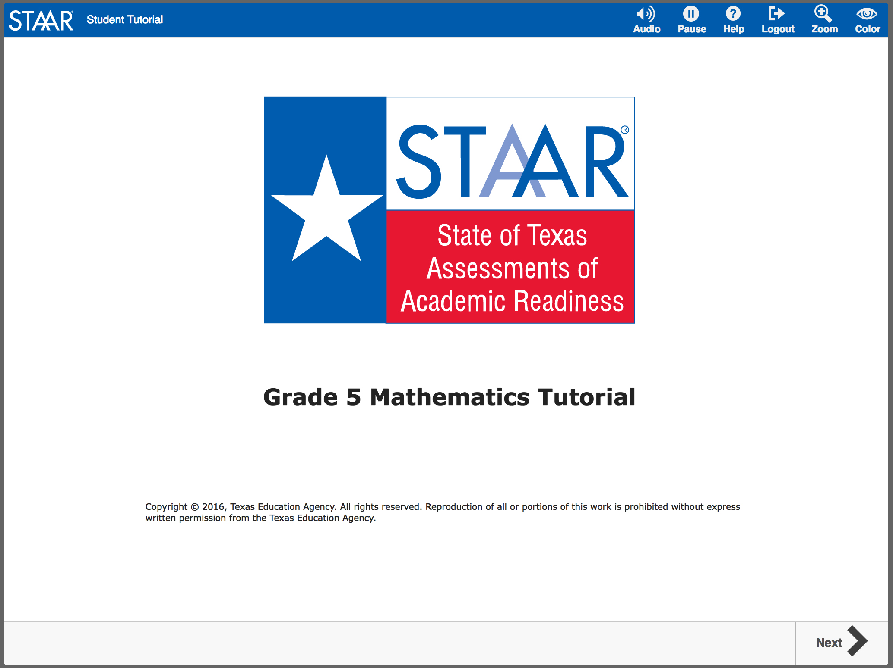
STAAR Online Tutorials
You will know you are in the right place when you see the logo screen and title.

Slide 6
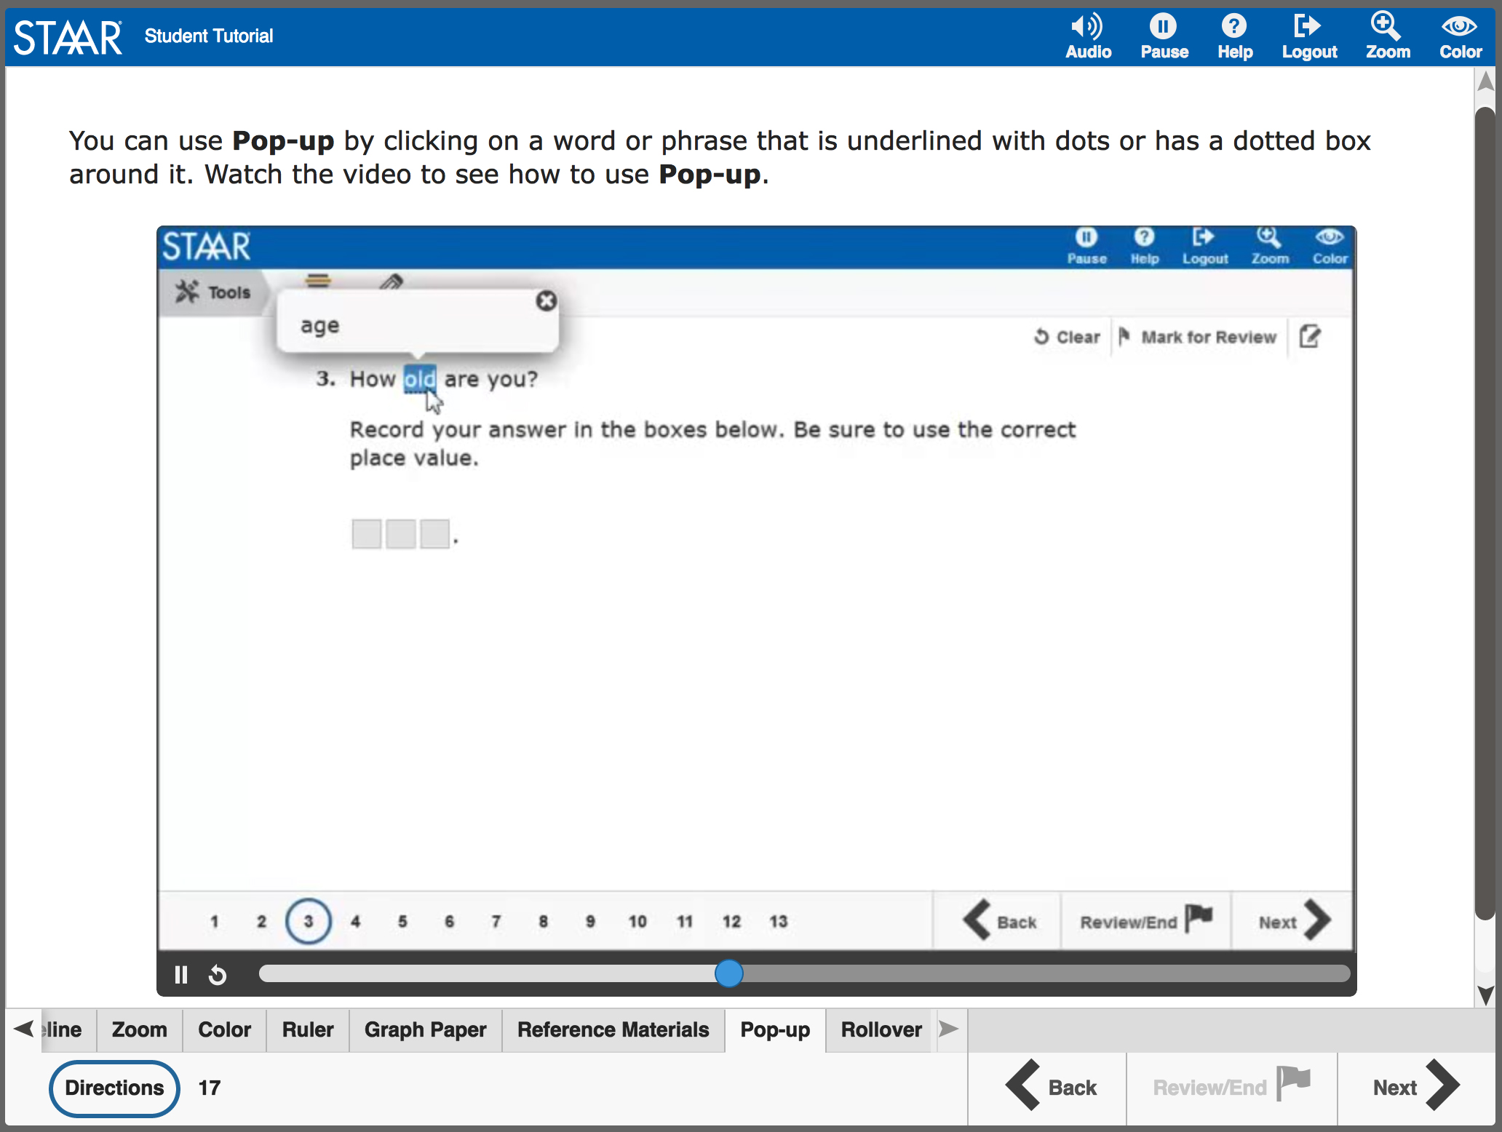
STAAR Online Tutorials
Tabs at the bottom of the screen act as a table of contents. Each tab contains a page that explains the online feature/tool and provides a short video.
Note: Videos do not have sound except for the Speak and Audio videos, which only read aloud the text on the screen.
Will be updated for 2018 Administration

Slide 7
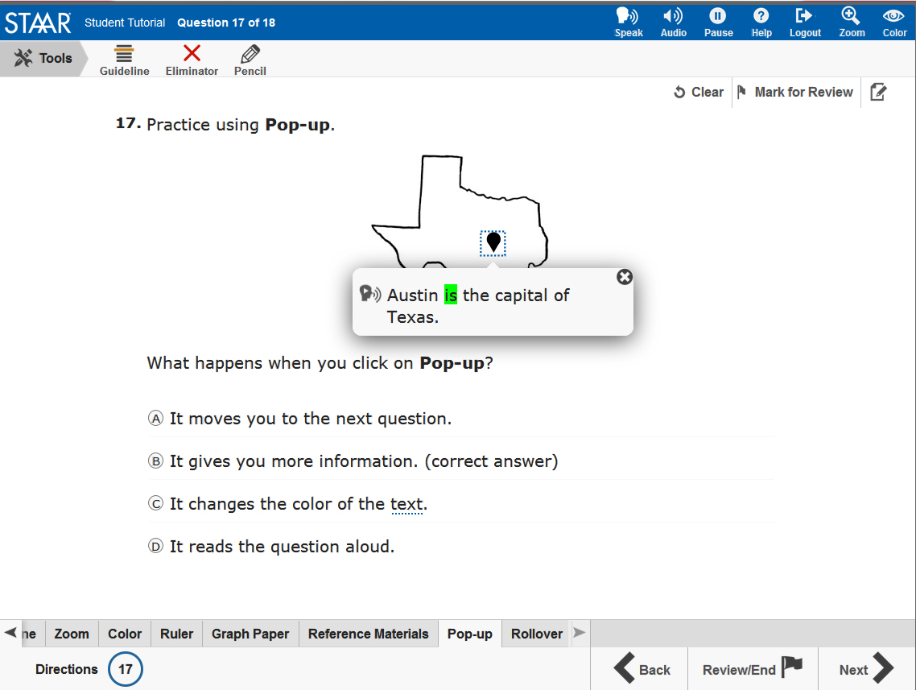
STAAR Online Tutorials
The second page of each tab has a question that you can use to practice with the feature/tool you just learned about.
Note: The questions do NOT contain tested content but are only intended to practice using the feature/tool.
Will be updated for 2018 Administration

Slide 8

STAAR Practice
When you open the STAAR online testing platform, you will see a menu of options, including “Practice.”
Here you will find released tests for 2016 and 2017.

Slide 9
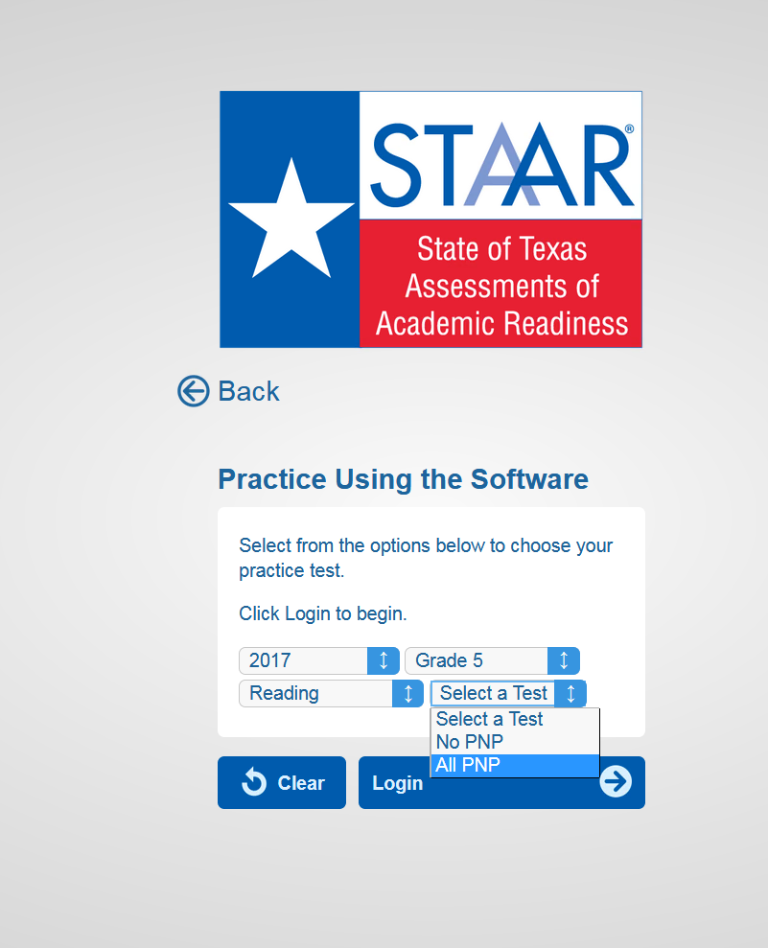
STAAR Practice
To practice taking the test with all supports (i.e., TTS, pre-reads, pop-ups and rollovers), select “All PNP”.

Slide 10


Slide 11
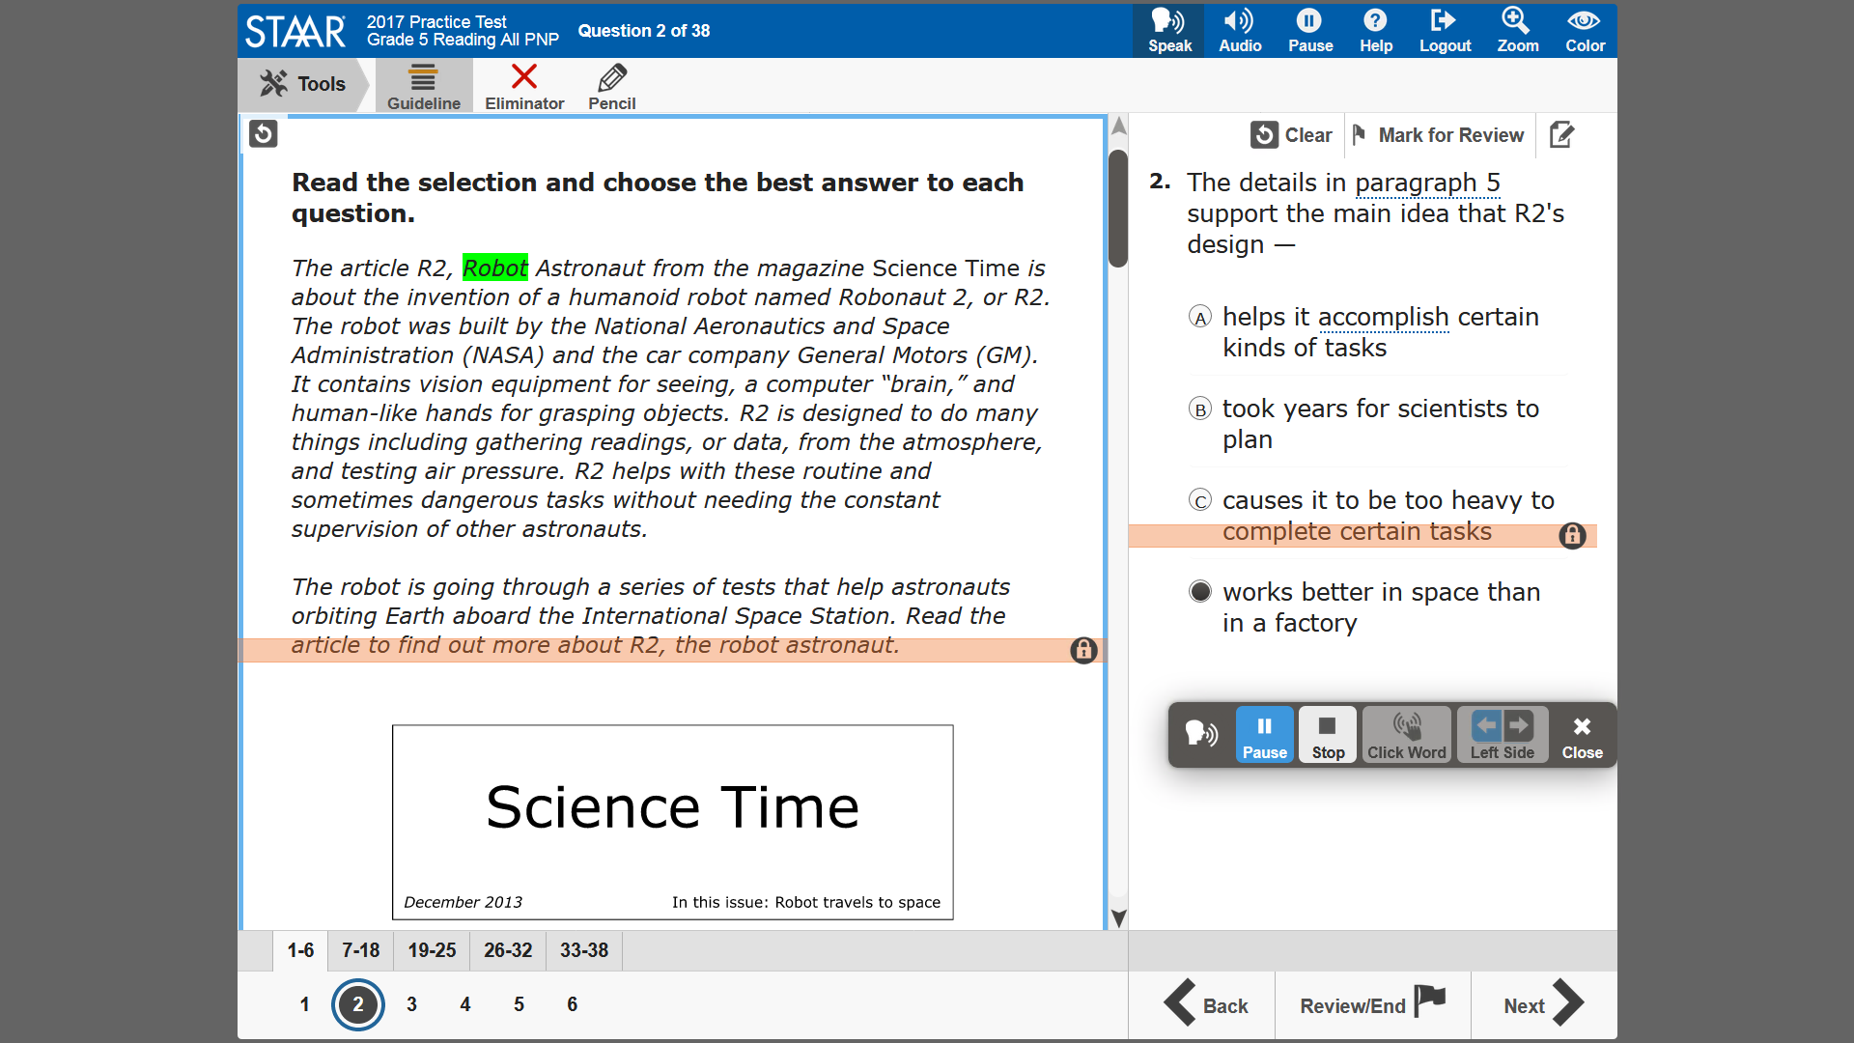

Slide 12
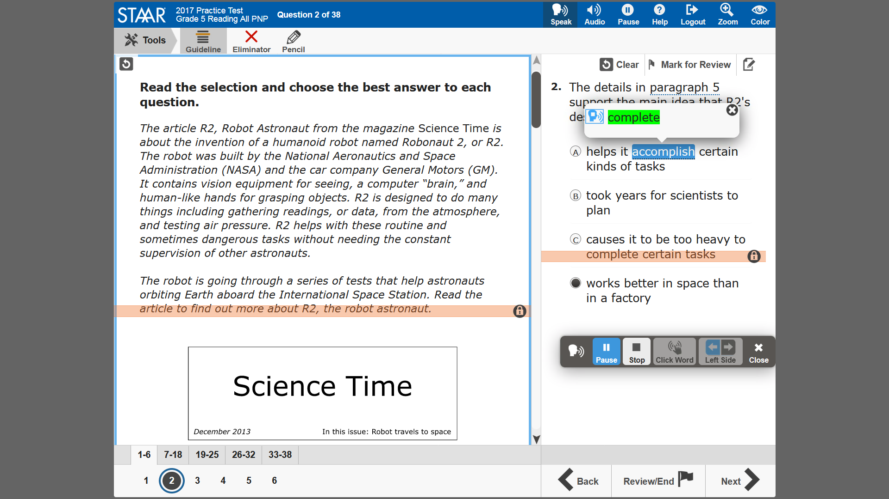

Slide 13

What is the instructional impact of these changes?
©2017 Region One Education Service Center
Notes:
Go back to original table and discuss

Slide 14
LPAC Documentation

Slide 15
Session Objectives
Content Objective
Today I explored different designated supports available for ELLs on state assessments.
Language Objective
Today I shared with my peers one designated support and I listened to their presentations.

Slide 16
HEAT Framework
High Order Thinking + Engagement + Authenticity + Technology Integration

Slide 17
Session Objectives
Content Objective
Today I will examine the HEAT Framework as a vehicle to increase ELL performance.
Language Objective
Today I will read and share with my peers what I learned about the HEAT Framework.

Slide 18
3 Step interview
“It’s the thought
that counts!”
Notes:
Get up and walk around during the song
When the song stops, find a partner
Introduce yourself
Discuss the phrase as it relates to you in an education setting
Be ready to come back to your tables to discuss what you heard (not what you said!)
Guided discussion: The role of the teacher is to develop good thinkers (long-life learners and problem solvers), not just good recipients of information (It’s the THOUGHT that counts)

Slide 19
Turning Up the HEAT!
H : Higher Order Thinking
E : Engaged Learning
A : Authentic Learning
T : Technology
Notes:
Divide participants in four groups and assign each group a letter: H E A T

Slide 20
Circle Map
Black: What I know
Blue: What I learned
from the text
H
Higher Order
Thinking
Red: What I learned from others
Notes:
1. Teachers write in black everything they know about their own category: H. E. A. or T.
2. Then they will read and discuss their category from the HEAT handout; they will add in blue what else they learned about their category
3. Teachers will post their charts and they will add in red what else they know about each category, through a gallery walk
4. Teams come back and debrief to summarize their findings
5. “Person with longest hair on each team stands up… and selects who will debrief the whole class”

Slide 22
Levels of Teaching Innovation Framework: LoTI
Cognitive Complexity
(High)
LoTi 6
LoTi 5
LoTi 4
Student-directed
LoTi 6
LoTi 5
LoTi 4
Problem-based
LoTi 3
LoTi 2
LoTi 1
Practice-based
LoTi 3
LoTi 2
LoTi 1
Teacher-directed
Cognitive Complexity
(Low)

Slide 23
H.E.A.T. Framework
Higher order thinking
Engaged Learning
Reporting Information
Remembering/Understanding
Applying/Analyzing
Solving teacher-directed problem
Evaluating/ Creating
Solving student directed problem-s
Expansive
Relevant
Limited
Connected
Vague
Authentic Connections
Technology Use
Non-use

Slide 24

Turning Up the HEAT!
Secondary: The Math Trail
Notes:
Click on the link to watch Ms. Toliver’s secondary video and ask participants to evaluate using the HEAT Framework
How could you turn up the HEAT on her lesson (move to the next level)?

Slide 25
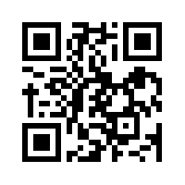
Let’s kahoot!
kahoot.it
create.kahoot.it

Slide 26
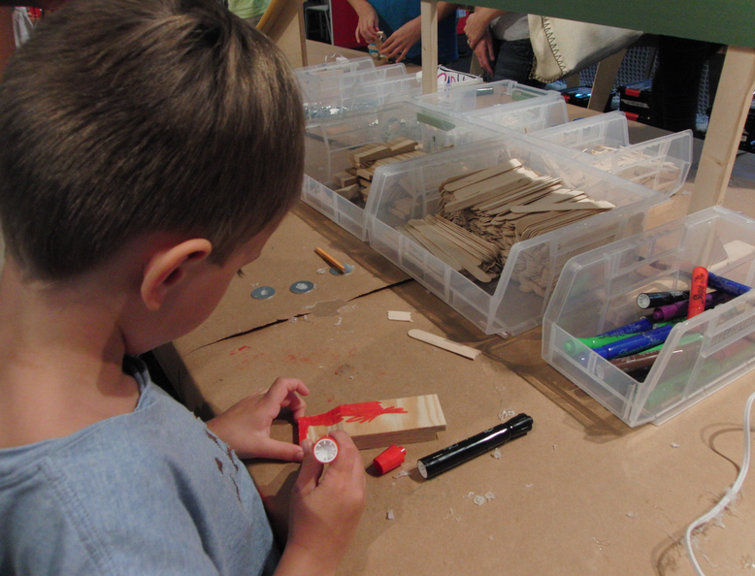
Turning Up the HEAT!
Elementary: The Tinkertoy Derby
Notes:
Click on the link to watch Ms. Toliver’s elementary video and ask participants to evaluate using the HEAT Framework
How could you turn up the HEAT on her lesson (move to the next level)?

Slide 27
Let’s kahoot!
kahoot.it
create.kahoot.it

Slide 29
How does the HEAT Framework fit into your plans?

Slide 30
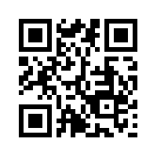
Tickets Out
http://backchannelchat.com/Backchannel/rdmr4
I used to think…
But now I know…

Slide 31
Thank you for your participation!
Karina E. Chapa, M.Ed.
Language Proficiency, Biliteracy and Cultural Diversity Director
kchapa@esc1.net
Facebook: Region One ESC Bilingual
Twitter @esc1bilingual @bilingualpride

